Slide 1
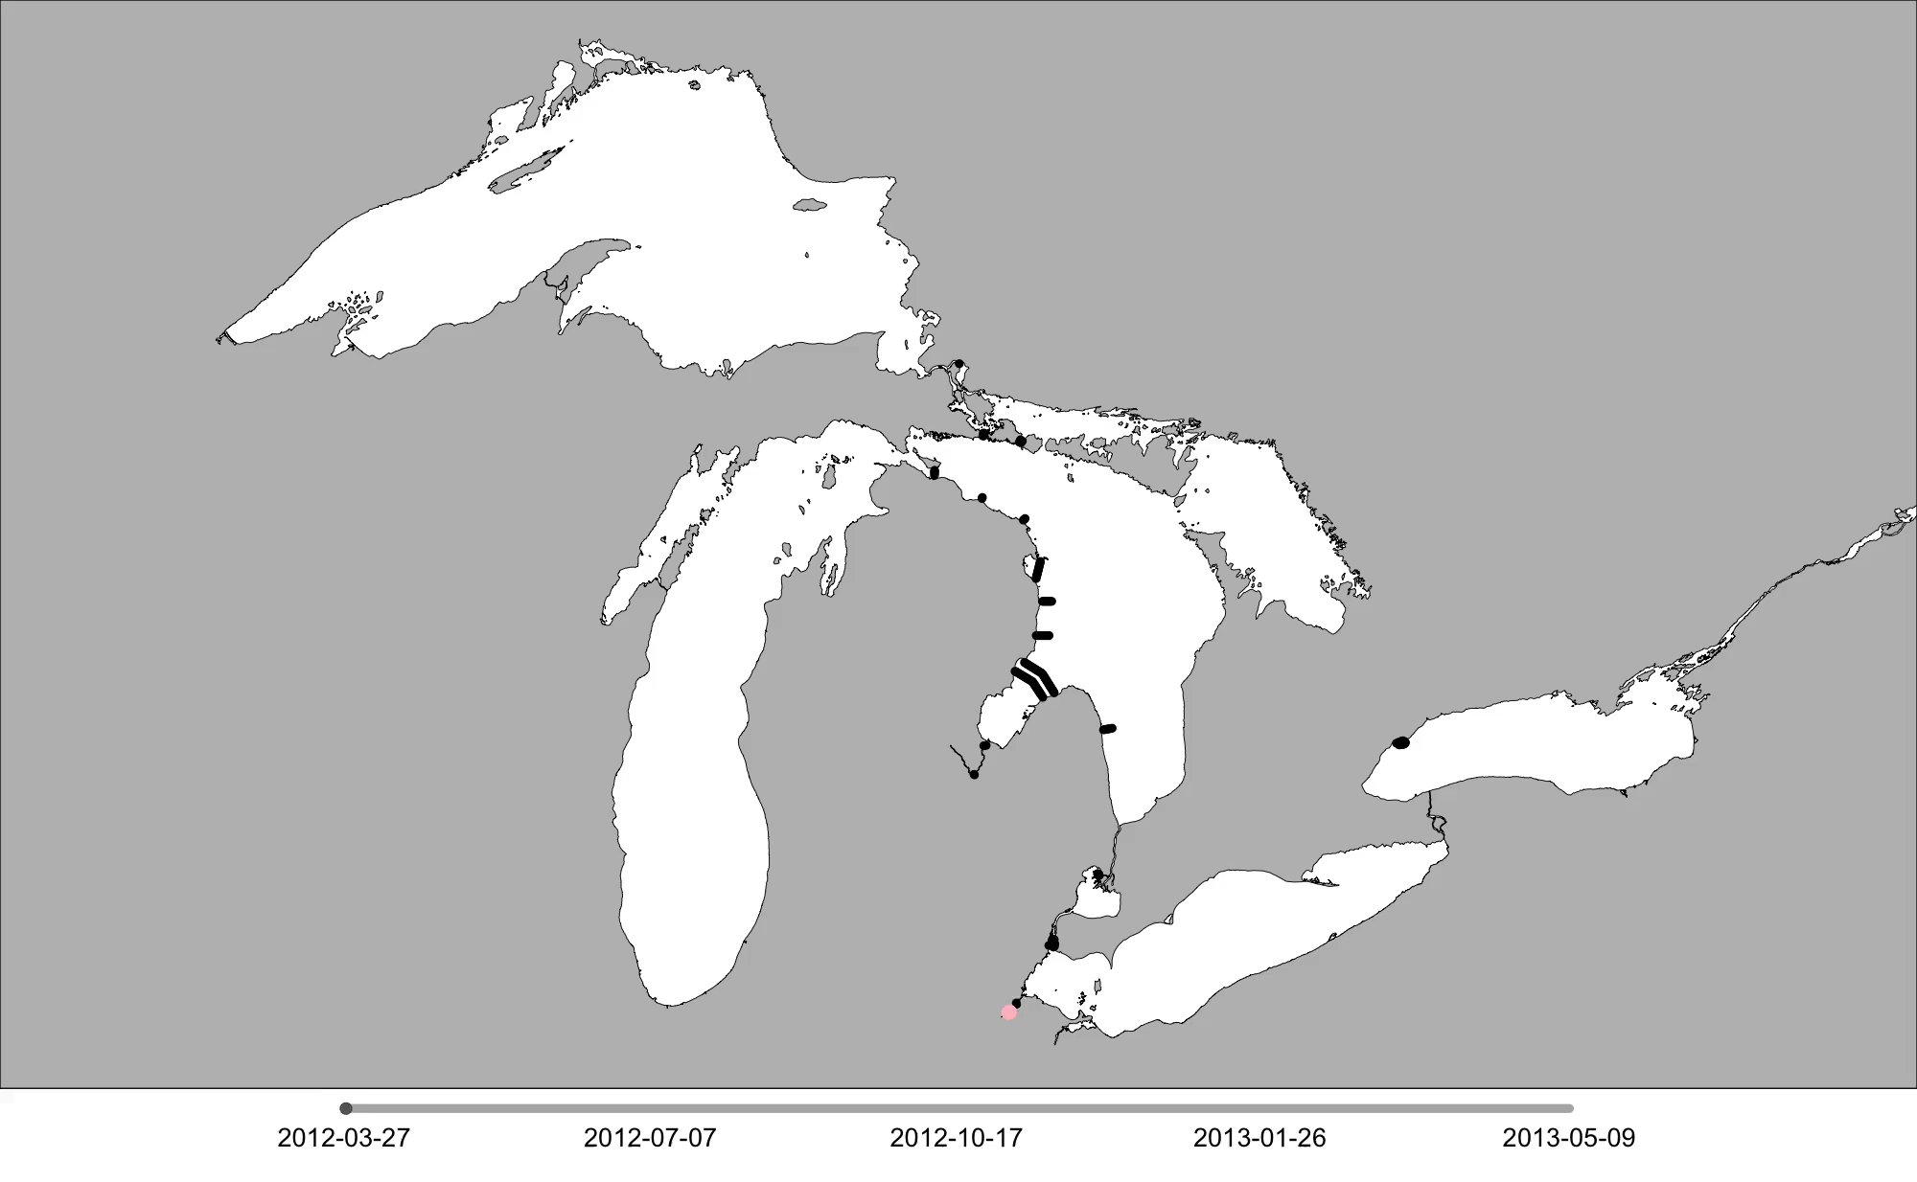

GLATOS R Package - Animations
Darryl Hondorp

Slide 2
GLATOS R Package - Animations
Part I: Why animate your data?
Part 2: Create animations from example data
Work flow and key functions
Example 1: Create a transition layer for non-linear interpolation (walleye in western Lake Erie)
Example 2: Create and customize a data animation (walleye in Lakes Huron and Erie)
Part 3: Make an animation using your own data

Slide 3
Why animate your data?
Increase memorability, understanding, and influence of study results
Ideal for describing and explaining changes in behavior
Caveat: most applicable to the early stages of exploratory data analysis
Caveat: requires assumptions that may bias rates and pathways of fish movement

Slide 4
Workflow
t₃
Lake Binder
t₂
t₁

Slide 5
Workflow
Create interpolated detection history with regularly-spaced time bins
Lake Binder

Slide 6
Workflow
Create interpolated detection history with regularly-spaced time bins
Linear interpolation
Non-linear interpolation (transition matrix)
Non-linear interpolation
Lake Binder
Linear interpolation
Notes:
Emphasize that non-linear is computationally more complex and therefore slower than linear

Slide 7
Workflow
Create interpolated detection history with regularly-spaced time bins
Linear interpolation
Non-linear interpolation (transition matrix)
Generate a series of plots showing the interpolated location of fish at each time bin (plots = “frames”)
Stitch plots (frames) together to create an animation
Non-linear interpolation
Lake Binder
Linear interpolation

Slide 8
Animations – Main Functions
Important functions:
interpolate_path
make_frames
make_transition
make_video
Main workhorse functions
Customization functions

Slide 9
GLATOS R Package - Animations
Part I: Why animate your data?
Part 2: Create animations from example data
Work flow and key functions
Example 1: Create a transition layer for non-linear interpolation (walleye in western Lake Erie)
Example 2: Create and customize a data animation (walleye in Lakes Huron and Erie)
Part 3: Make an animation using your own data

Slide 10
Example 1 - interpolate
Create a transition layer for non-linear interpolation
interpolate_path
Non-linear interpolation
data frame containing interpolated detection data for each fish
Lake Binder
Notes:
make_transition generates a “transition layer.” IE, a geo-corrected transition raster layer where land = 0 and water=1. That transition raster must be supplied to interpolate_path for non-linear interpolation

Slide 11
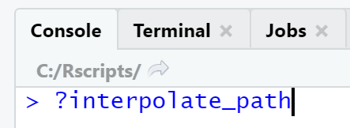
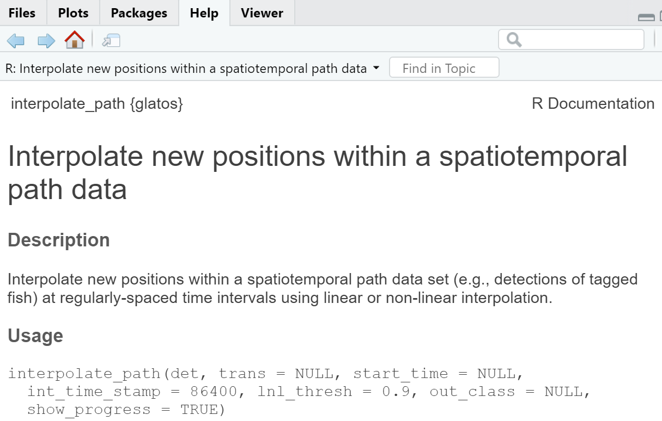
Example 1 - interpolate

Slide 12
Example 1 - interpolate

Slide 13
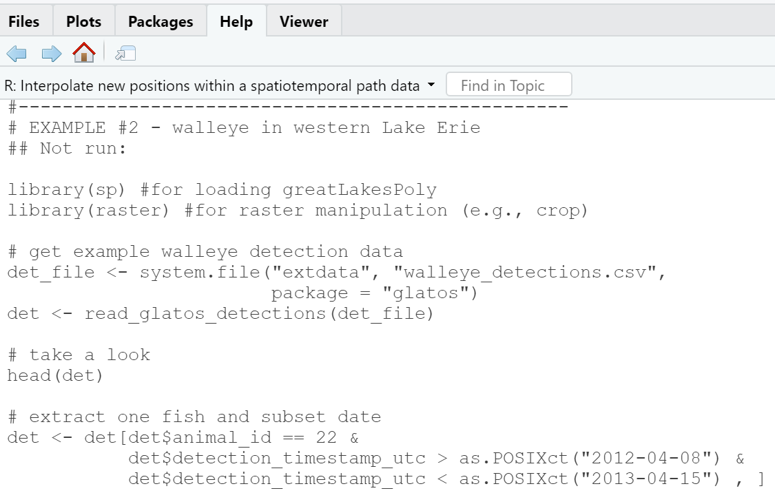
Example 1 - interpolate
cut & paste into
script editor

Slide 14
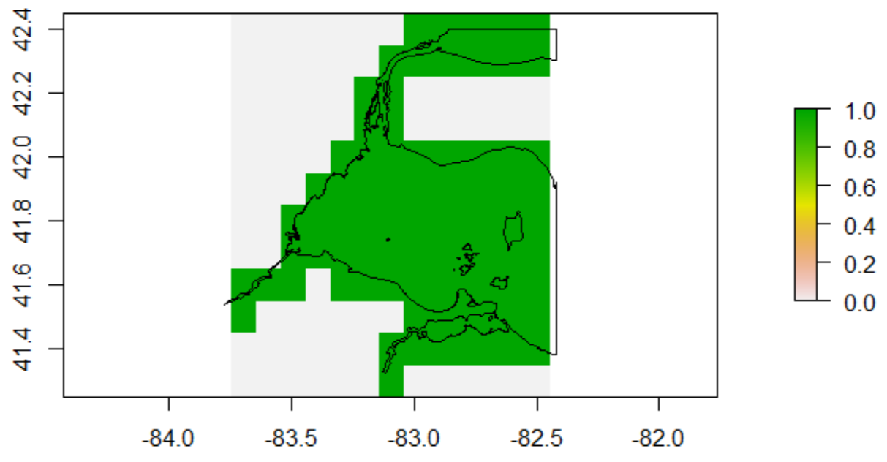
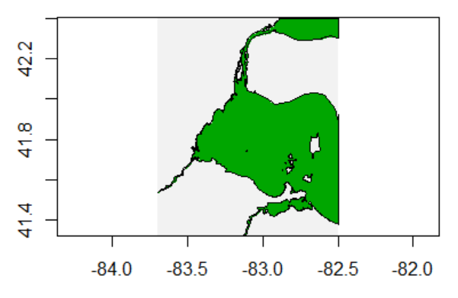
Example 1 - interpolate
res = c(0.1, 0.1)
res = c(0.001, 0.001)

Slide 15
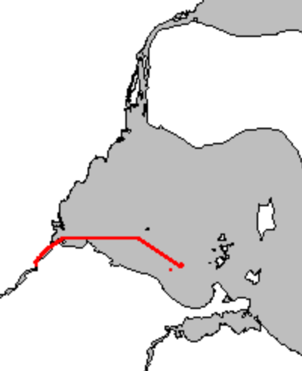
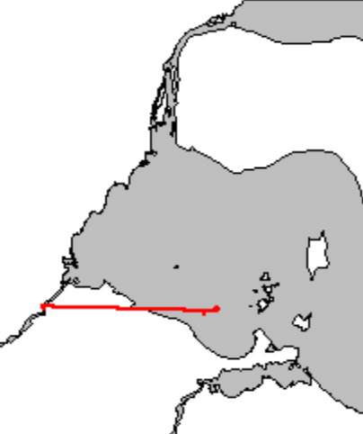
Example 1 - interpolate
Non-linear interpolation
Linear interpolation

Slide 16
GLATOS R Package - Animations
Part I: Why animate your data?
Part 2: Create animations from example data
Work flow and key functions
Example 1: Create a transition layer for non-linear interpolation (walleye in western Lake Erie)
Example 2: Create and customize a data animation (walleye in Lakes Huron and Erie)
Part 3: Make an animation using your own data

Slide 17
Example 2 - Create and Customize Animation
data frame of interpolated detections
make_frames
a png file for for each time bin in the data frame + optional mp4 file of stitched png frames
Lake Binder

Slide 18
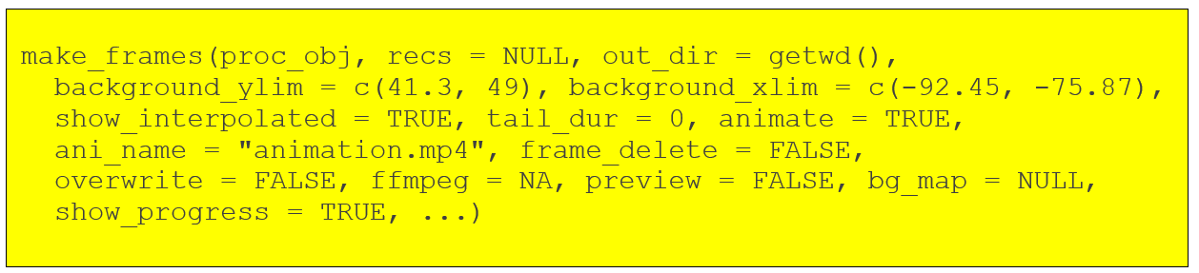
Example 2 - Create and Customize Animation
data frame of interpolated detections
make_frames
a png file for for each time bin in the data frame + optional mp4 file of stitched png frames

Slide 19
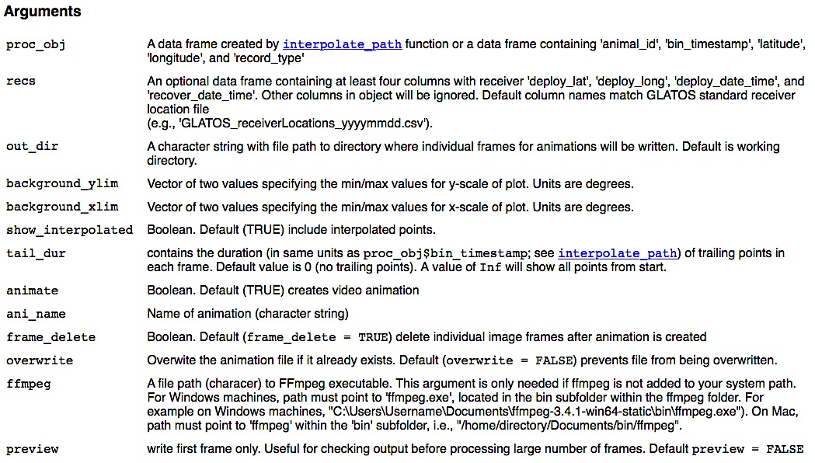
Example 2 - Create and Customize Animation
Set animate=FALSE if you wish to stitch the frames together using another program

Slide 20
Example 2 - Create and Customize Animation
data frame of interpolated detections
make_frames
a png file for for each time bin in the data frame + optional mp4 file of stitched png frames

Slide 21
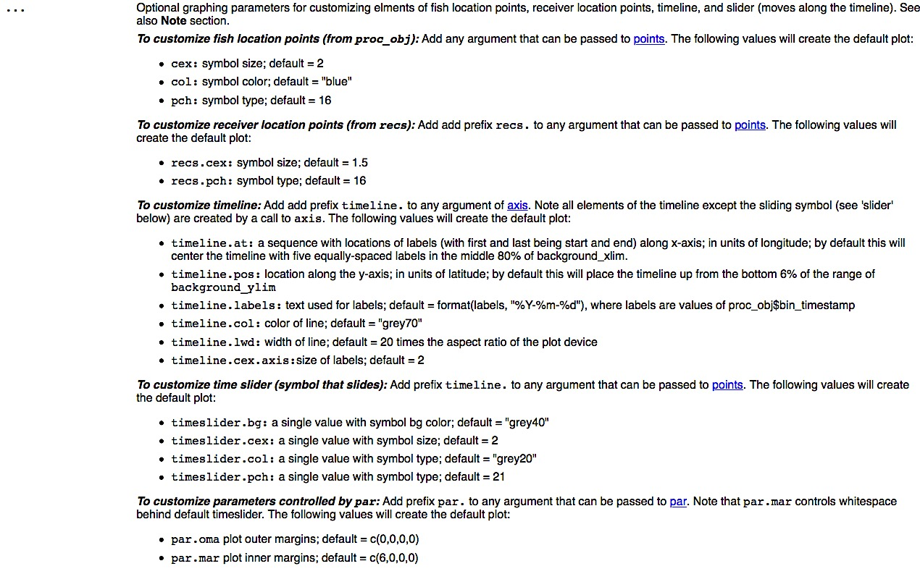
Example 2 - Create and Customize Animation

Slide 22
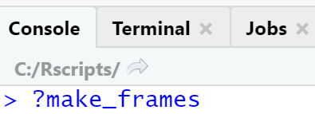
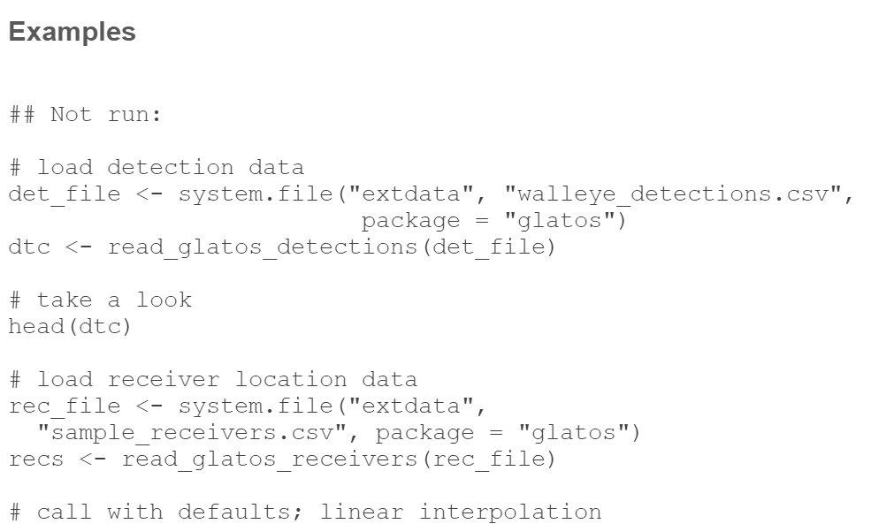
Example 2 - Create and Customize Animation

Slide 23
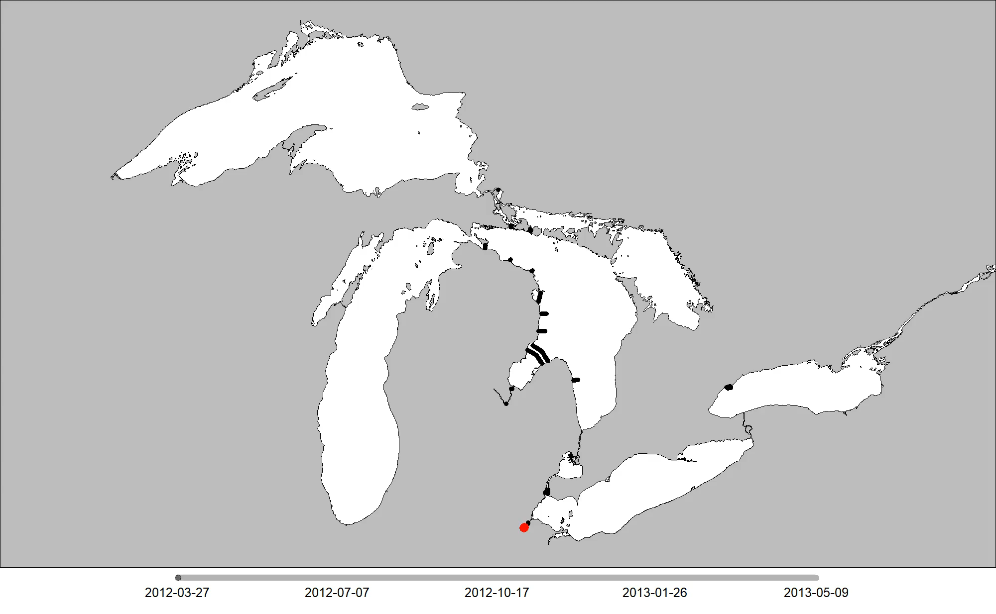
Example 2 - Create and Customize Animation
Frames3 output:

Slide 24
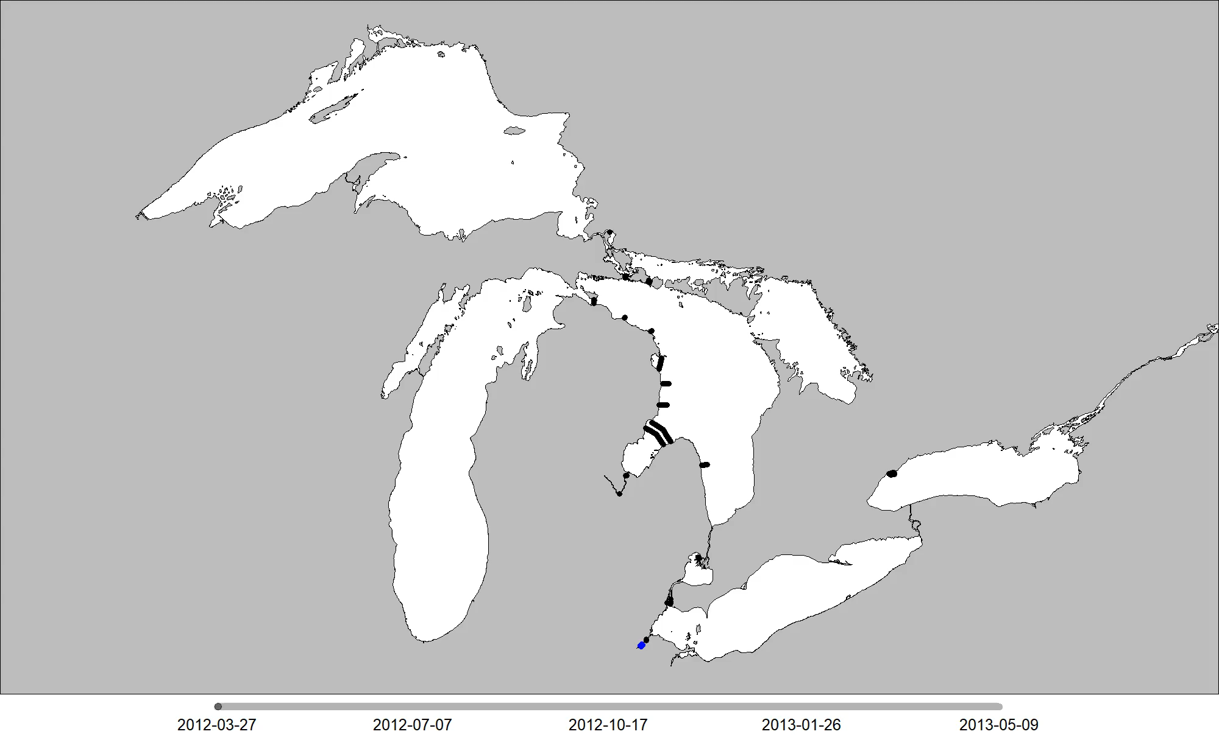
Example 2 - Create and Customize Animation
Frames4 output:

Slide 25
GLATOS R Package - Animations
Part I: Why animate your data?
Part 2: Create animations from example data
Work flow and key functions
Example 1: Create a transition layer for non-linear interpolation (walleye in western Lake Erie)
Example 2: Create and customize a data animation (walleye in Lakes Huron and Erie)
Part 3: Make an animation using your own data

Slide 26
Make an animation with your data
Suggestion:
Subset your detection data to include only 1-3 unique id’s
Use interpolate_path to create a data frame of interpolated positions
if necessary, use make_transition to create a transition layer
Create & customize frames using make_frames
Use make_video to isolate sequences of interest and/or adjust playback speed

